Slide 1
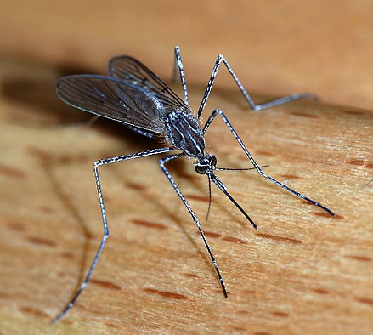
West Nile Virus Prediction

Slide 2
Main dataset
Date
Latitude, Longitude
Number of Mosquitos
West Nile Virus Present

Slide 3
Weather Data Set

